Slide 2
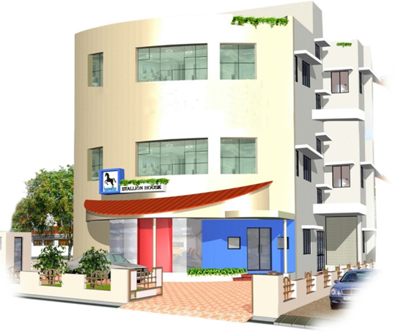
Headquartered in Kochi, Kerala, one of India’s leading IT hub
Wide reach with a nationwide network of 16 direct branch offices
International operations in UAE, Qatar & Oman
STALLION Highlights
About
Launched 2 decades ago, Stallion is a premium vendor in the AIDC industry providing solutions in India & Middle East.
Tailor made solutions as per customer requirements in AIDC technologies like Barcode & RFID
Wide range of cost effective RFID infrastructure
Over 20000 privileged customers
Manufacturing units at Kochi, Bangalore, Mumbai & Dubai (UAE) for tags & consumables
POS terminals for Retail industry
Proven track record in providing Warehouse, Asset & Inventory management solutions
Document Archiving Solutions
Solutions for Manufacturing Assembly Lines
HR Real time monitoring Attendance Systems
Visitor management and many more solutions..

Slide 3
CURRENT MANUAL PROCESS
REGISTER/BOOK TO LOG VISITOR INFORMATION
There will be registers or books in security gates / reception where user can enter his information and can proceed for the meeting
SECURITY VERIFICATION
Security will call the host over phone and take approval over phone
BADGE / LANYARD WITH PASS
Security will issue a badge or lanyard with a predefined number and this will get logged in the register and then visitor proceeds for the meeting
RETURN OF THE BADGE WHILE RETURNING
Visitor will return the badge while moving out and security will mark the exit time

Slide 4
DRAWBACKS OF MANUAL VMS
SHARED PEN / BOOK / LANYARD ETC. CAN SPREAD VIRUS
MANUAL RECONCILIATION IS HECTIC TO GET THE LIST OF VISITORS INSIDE. POOR DATA VISIBILITY TO MANAGEMENT
OUTDATED AND UNPREFESSIONAL, REDUCES THE BRAND IMAGE
INFORMATION IS NOT RELIABLE, ILLEGIBILITY IN HANDWRITING, MAY LEAD TO NON USABLE DATA

Slide 5
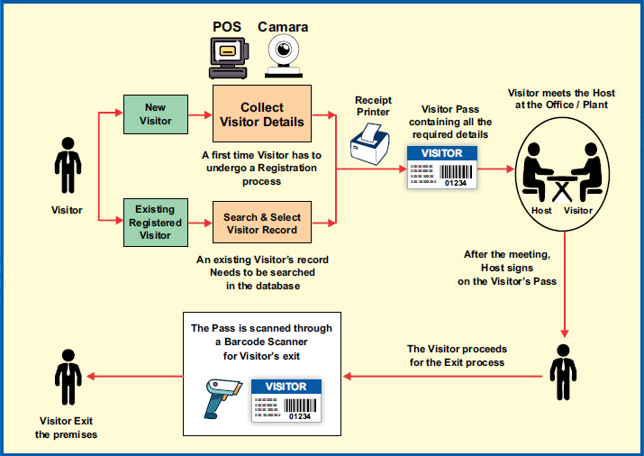
PROCESS FLOW

Slide 6
STALLION VMS - FEATURES
VISITOR CHECK IN
MULTI COMPANY FACILITY
VISITOR INFORMATION WILL GET CAPTURED IN VMS
SAME APPLICATION CAN BE USED FOR MULTIPLE COMPANIES
PASS PRINTING
USER FRIENDLY REPORTS
BASED ON DATA ENTERED PASS WITH PHOTOGRAPH WILL BE PRINTED USING THERMAL PRINTER
VERY MUCH USEFUL AND EFFECTIVE REPORTS AND DASHBOARDS
EASY CHECKOUT
SMS / EMAIL alerts
BY SCANNING THE BARCODE ON THE PASS VISITOR CAN EASILY CHECKOUT
ALERTS CAN BE GENERATED IF PEOPLE IS STILL IN ORAGANIZTION AFTER ALLOWED BUSINESS HOURS

Slide 7
KEY BENEFITS
Avoid the spread of virus
VMS will help to avoid the shared usage of pen, register, lanyard etc. This will help to avoid the spread of virus
Centralized data
VMS will maintain the centralized data and can access in few clicks and maintain for a longer period
Enhance compliance
Keep a record of the Ins and OUTs of people will improve the visibility of the data with minimal efforts
Better brand image
Professional VMS in place of manual registers will help to improve organization's image
Strengthen Security
Know exactly who, where, why and when a visitor is onsite
Reduced the operating cost
Recurring Investment for manual registers and pen , time to reconcile data, space for keeping records etc will reduce drastically

Slide 8
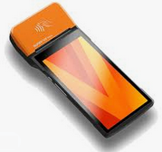
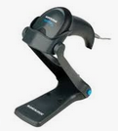
SOLUTION PORTFOLIO
SOLUTION 1 | SOLUTION 2
SUNMI V2 PRO HANDHELD POS WITH BUILT IN PRINTER STALLION VMS Software | SUNMI T2 DESKTOP POS WITH CAMERA AND THERMAL PRINTER STALLION VMS Software
THERMAL ROLLS | BARCODE SCANNER THERMAL ROLLS

